Slide 1
ECE231 Final Porject
Acequia Manager: Water Resource Simulator

Slide 2
Acequia: a Brief Context
Water resources in New Mexico are connected by a large network of canals that deliver water to communities
Within New Mexico, these canals are commonly known as Acequias
Their common purpose has been to deliver water for irrigation to crops and ranching
In the case of this simulator, Acequias serve as a metaphor for water transfer that is NOT exclusive to irrigation.
Rather, these “canals” consider water movement across the state

Slide 3
Why Acequia Manager Simulation?
This exercise is intended to build on using programming languages to solve real-life problems
We hope to strengthen a student’s problem-solving skills using C++
We hope to enable this exercise in an environment that is analogous to coding interviews

Slide 4
How the Simulator Works
North Region:
WaterSources
Rio Grande River
ABQ Aquifer
Pecos River
WaterLevel
4.301 (acre-feet)
Flooded? No
Drought? No
Canal A:
Tapped from Rio Grande
Source Region: North
Destination Region: South
The Simulator populates the vectors for Regions, Water Sources, and Canals
Each class object will be assigned random values
The values of each region object will be displayed on the screen as such:
Region: Name Water Level: _____ Flooded:____ Drought:_____
South Region:
waterSources
Elephant Butte Dam
Rio Grande River
WaterLevel
1.301 (acre-feet)
Flooded? No
Drought? Yes

Slide 5
How the Simulator Works (cont.)
Based on these values, the student is provided getter functions to access the members of: region, waterSources, and canals
Students will facilitate the transfer of water resources from one region to another using the canals objects in the solve problem function
Students are given a certain number of hours (simulation time units) that they can implement actions to address distribution of water resources across all regions
In those actions, the student may open and close canals, and adjust flow rates

Slide 6
How the Simulator Works (cont.)
Once the solve problem function has been added, the simulator evaluates the final state of each region and scores one point based on satisfying the following criteria:
The waterLevel of the region is above or equal to the waterNeed of the region
The region is NOT flooded. That is indicated by the Boolean, isFlooded
The region is NOT in Drought. That is indicated by the Boolean, isInDrought
A total score is computed and reported with the current leaderboard presented

Slide 7
Simulator Description
The simulator handles
populating each vector class with Random Parameters and Constraints
displaying the information about the particular problem
The progress of the simulator (hours provided to the student)
And the exchanges in water resources between regions
evaluating the final states of each region and administering a score after the student’s solveProblems function has been implemented
Displaying the Leaderboard for the simulator

Slide 8
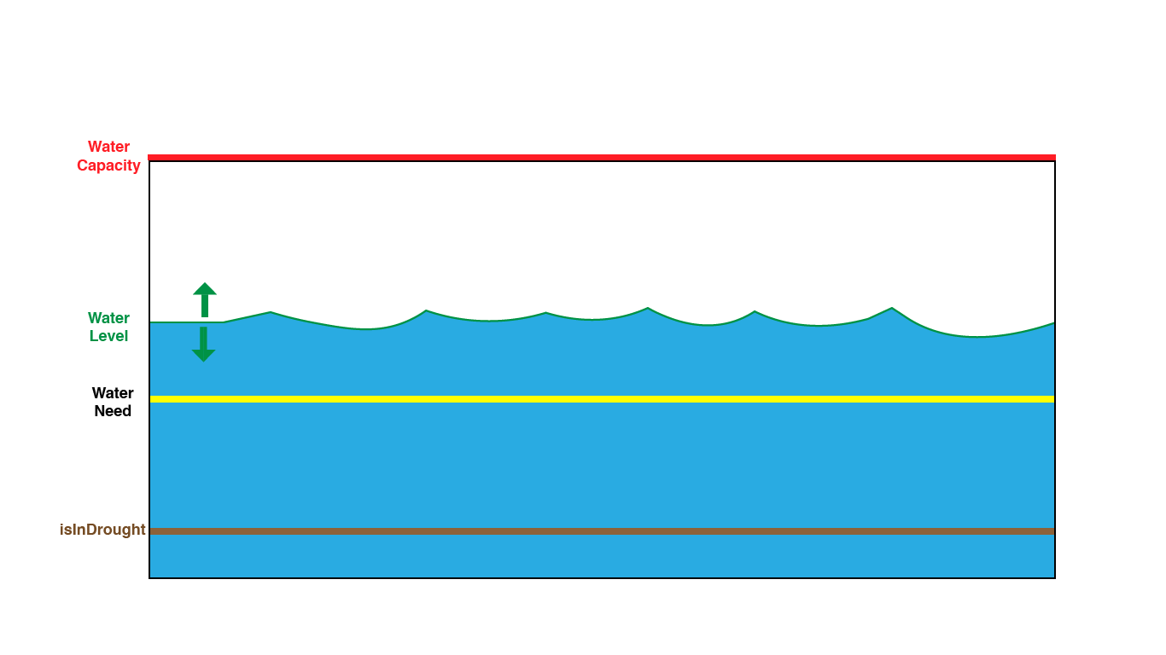
Region Class Members
WaterLevel(double): Shows the current water level of the region
WaterNeed(double): shows the amount of water needed to support the communities of the region
waterCapacity(double): shows the amount of water the region can hold before flooding
isInDrought(bool): Shows the status of the region when water levels have reached drought levels
isFlooded(bool): Shows the status of whether the water levels have reached flooding conditions

Slide 9
Region Class Members cont.
Vector of WaterSources (vector<WaterSource *>)
Rivers, dams and aquifers that supply water to that region

Slide 10
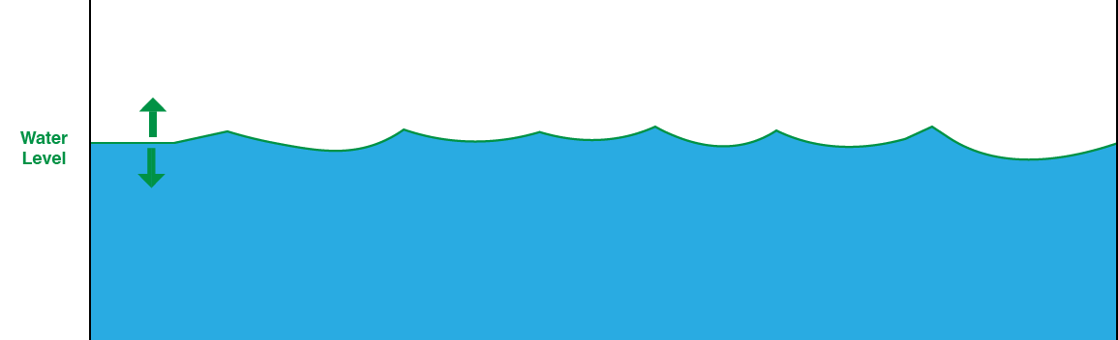
WaterSource Class Members
Name
WaterLevel (double)
WaterSourceType
River
Dam
Underground
Canals (std::vector<Canals*>)

Slide 11
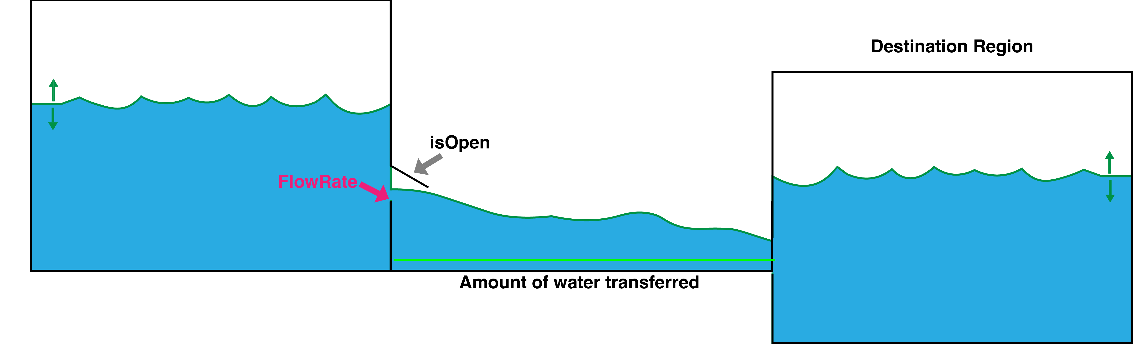
Canal Class Members
Name
sourceRegion(Region *)
DestinationRegion (Region *)
waterSource (WaterSource *)
flowrate (double)
isOpen (bool)

Slide 12
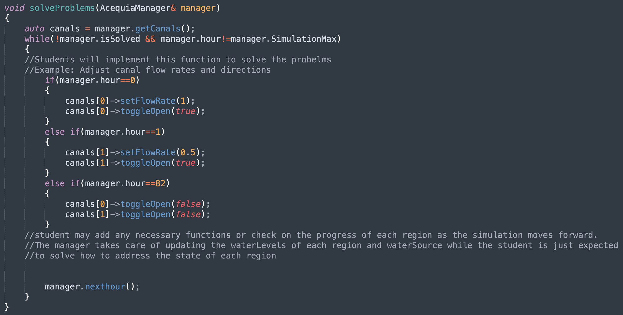
SolveProblems Function
The solveProblems function can be found in the StudentSolution.cpp file
In this function, the student will code the logic for how to solve the distribution of water resources
Student can move water by opening/closing canals and setting flow rates (0 to 1 gal/s)

Slide 13
.nexthour()
This function handles the progress of the simulator and how many actions a student can initiate during that hour and how that changes the water levels of the different regions
Hour 1
Hour 2
Hour 3
Open Canal A
SetflowRate(.4)
Close Canal A
Open Canal B
SetflowRate(.9)
Close Canal B

Slide 14
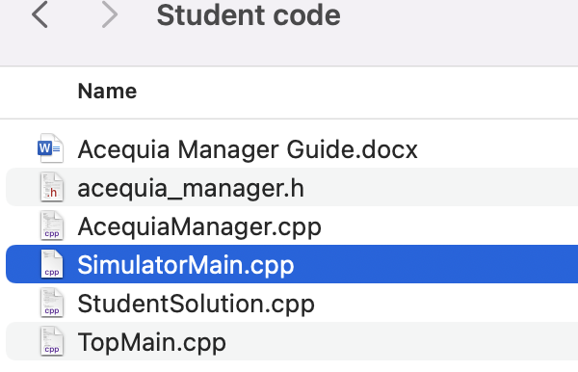
Getting Started
Download all files:
TopMain.cpp
AcequiaManager.cpp
StudentSolution.cpp
SimulatorMain.cpp
AcequiaManager.h

Slide 15
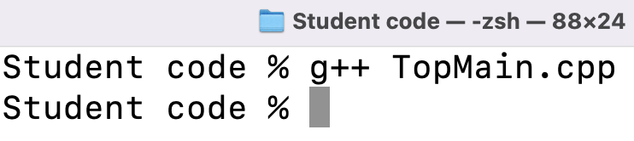
Getting Started (cont.)
Compile TopMain.cpp
Execute the file
Ex: ./a.out

Slide 16
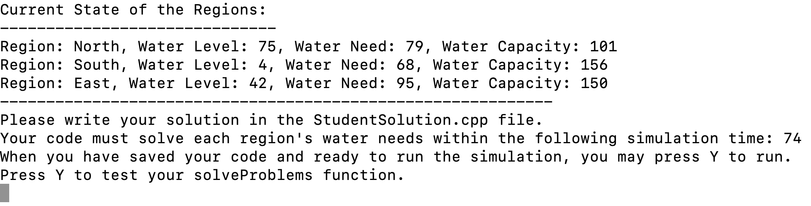
Running TopMain.cpp
When running the TopMain.cpp, the user will receive:
The initial conditions of each region
The simulation time they have to solve the water management
Lastly, they will be prompted to press Y when ready to test their solveProblem Function
Press when ready to activate Simulator

Slide 17
Before Pressing Y
Prior to activating the simulator,
The user will enter instructions on the solveProblem function based on the parameters provided
Save the modified StudentSoltuion.cpp file
Press Y to activate the simulator

Slide 18
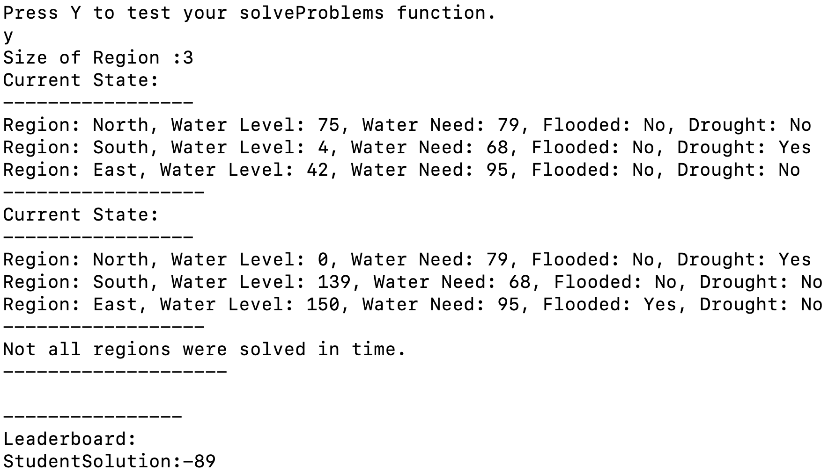
Activating the Simulator
When the simulator is launched,
The user will be provided the final state of each region.
Water level, water need, if the region is flooded, or in drought
They will be notified if their solution solved the problem prior to the max time
If so, their solved time will be reported
They will receive a score

Slide 19
Scoring Criteria
Earned Points:
+10
For each region that satisfies:
Water level above water need
Is not flooded
Is not in drought
+50
If solveProblem() function solves each region before max simulation time
Penalties:
-1
For each hour a region is in a flooded state
-1
For each hour a region is in a drought state

